Slide 1
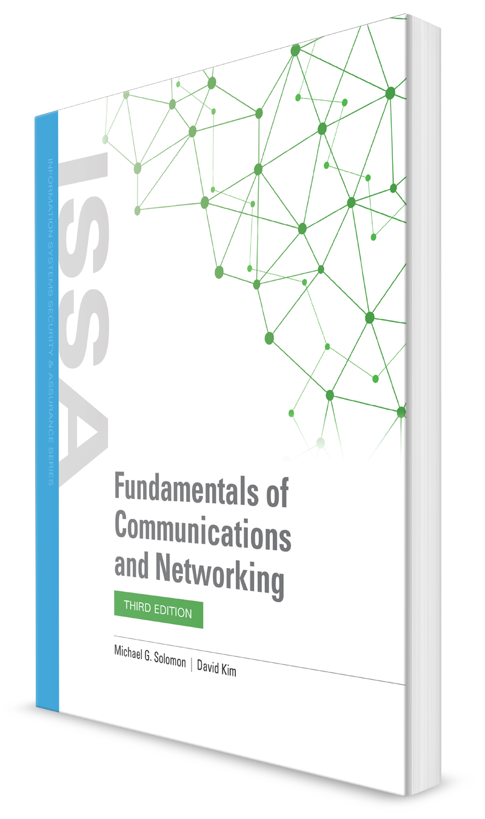
Solving Today’s Business Communication Challenges
CHAPTER 2

Slide 2
Learning Objective(s) and Key Concepts
Learning Objective(s)
Key Concepts
Explain how the evolution of communications and networking technologies solves business challenges.
Business communication challenges
How the public sector and private industry solve business communication challenges
How to transform communication requirements into network requirements
How to define an organization’s networking requirements

Slide 3
Organizational Communication Challenges
Challenges
Being “off the air”
Constantly sending reminders and updates
Disconnected messaging
Fixes
Act fast
Clarify deliverables
Set (or reset) expectations
Try a different method
Unified communications (UC) can address the most important business challenges by making communication more efficient
Notes:
See that people will be online
Make sure that people are doing their work
Every technology fulfill a need (that need produces it)

Slide 4
notes
Organization classifications
Enterprise – more than 500 employees
Medium-sized – more than 100, fewer than 500
Small – fewer than 100
Small office/home office (SOHO) – fewer than 10
Government – a government department agency
Session Initialization Protocol (SIP) – UC and other apps use for presence/availability (technology that allows geographic location of a human or nonhuman resource to be determined), IM, chat, collab, audio/video conferencing
Small and medium-sized business = SMB

Slide 5
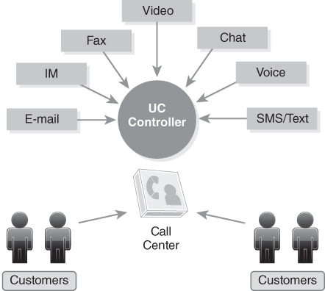
Today’s Multimodal Business Communication Options
FIGURE 2-1 Today’s multimodal business communication options.

Slide 6

Enterprise Challenges
Enterprise businesses have 500+ employees
Communications are split among multiple devices and applications
IT departments need to maintain many devices and apps and keep them all secure with minimal cost
Work/life balance is threatened by work communication on personal devices outside of normal business hours
Secure environments must be maintained to protect all regulated and unregulated content and ensure that it is acquired and managed effectively and in compliance with regulations
The customer experience needs to be improved through consistent and personalized communications utilizing the best channels
Notes:
Encounter 3 main operational challenges:
Reducing costs
Improving team collaboration
Providing better customer service

Slide 7
Government Communication Challenges
Keeping constituents engaged, active, and responsive
Addressing the demands of paper-based processes
Dealing with obstacles presented by legacy systems
Meeting an increasing number of requirements with shrinking budgets

Slide 8
SMB/SOHO Challenges
Comprehensive customer service
Marketing reach
Limited customer base
Competing demands for budget
SMB perception
Notes:
SMB perception – important that it doesn’t appear smaller or limited so that customers and partners can perceive that it can meet their needs

Slide 9
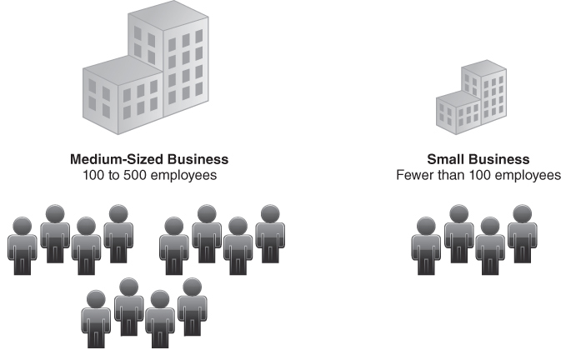
Small and Medium-Sized Businesses (SMBs)
FIGURE 2-2 Small and medium-sized businesses (SMBs).

Slide 10
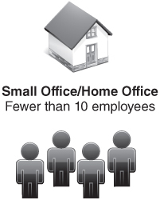
Small Office/Home Office (SOHO) Business
FIGURE 2-3 Small office/home office (SOHO) business.
Notes:
Flexibility of telecommuting and remote access

Slide 11
notes
SOHO challenges:
Competing with enterprises and SMBs
Reaching the customer
Managing time
Operating on a limited budget
Meeting customer needs
Maintaining security

Slide 12
Solving Enterprise Business Communication Challenges
Identify the problem
Formulate a business solution
Develop a technical solution that meets the business requirements
Notes:
Protocol = a set of rules that define a particular aspect of communication

Slide 13
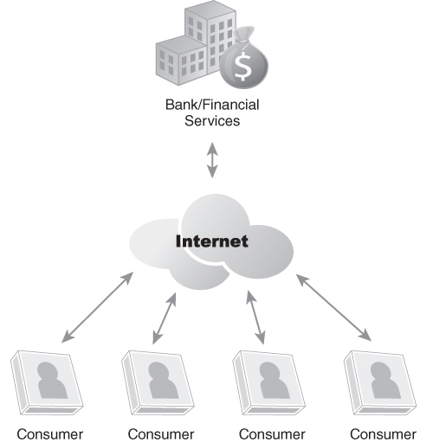
Banking and Financial Services Challenges
Need timely, secure, clear, and reliable customer communications
Confidentiality and integrity are very important
Example UC solutions:
Chat or audio/video conferencing at automated teller machines (ATMs)
Integrated analysis training and tools
Multimodal trade alerts and execution
FIGURE 2-4 Banking and financial services business.
Notes:
Services include
Maintaining bank accounts
Managing investment portfolios
Trading in securities
Making loans and mortgages
Financial planning
Confidentiality – assurance that only authorized users can access or view data
Integrity – assurance that only authorized users can modify data

Slide 14

Health Care and Patient Care Services Challenges
Challenges are similar to banking and financial services
Protected health information (PHI) is key
Primary goals:
To enhance patient care services
To eliminate human delays in life-threatening situations
Example UC real-time solutions:
Access to accurate and pertinent patient healthcare information and status
Access to medical specialists and experts to provide critical, time-sensitive input
Self-service patient services delivered via web applications
Notes:
Timely, secure, and clear and reliable

Slide 15
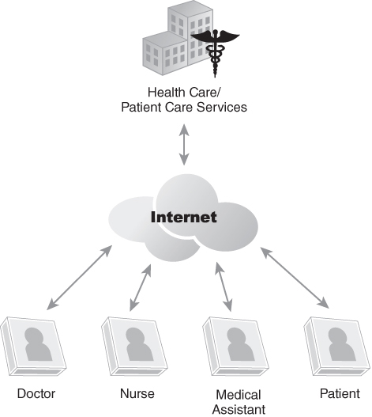
Health Care and Patient Care Services Business
FIGURE 2-5 Health care and patient care services business.

Slide 16
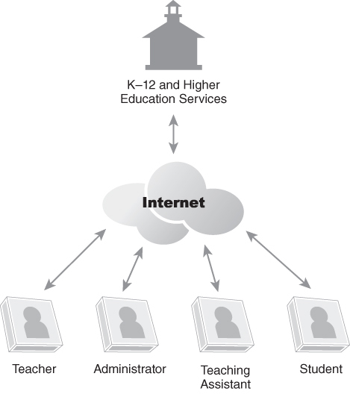
K–12 and Higher Education Services Challenges
Information must be accurate, secure, clear, and available
Multimodal communication solutions:
IM chat and audio/video conferencing during registration
Real-time remote advisement
Automated response system for common questions
Automated student/faculty interaction application
Interactive grade distribution and explanation
FIGURE 2-6 K–12 and higher education services business.
Notes:
PII (personally identificable information)

Slide 17

Commercial Retail Products and Services Challenges
Main challenges:
Reaching out to new customers
Standing out from other businesses
Meeting existing customer needs
Keeping customers informed of news and updates
Securing customer data
UC solutions:
IM chat, audio, or video conferencing to provide live customer service
Online ordering with flexible delivery options
Extensive purchasing assistance to increase add-on sales
Notes:
Final purchase decision depends on factors:
Purchase price
Availability
Shipping cost
After-sales support

Slide 18
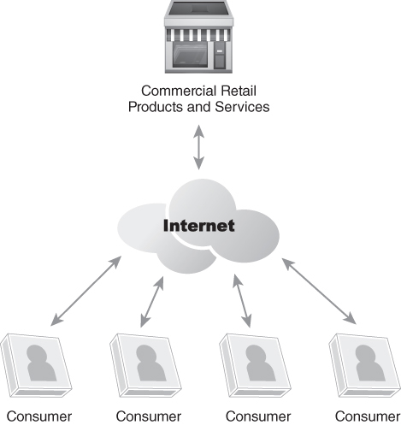
Commercial Retail Products and Services Business
FIGURE 2-7 Commercial retail products and services business.

Slide 19
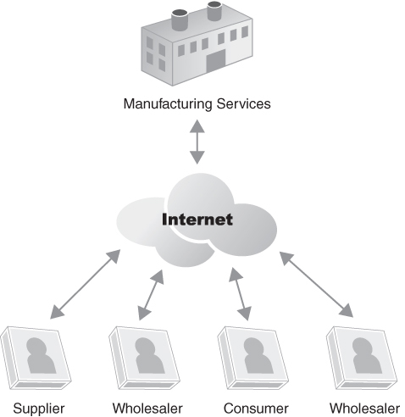
Manufacturing Services Challenges
Organizations can streamline the operational process by automating and linking individual activities, such as:
Sales order entry
Purchasing
Supply chain management
Just-in-time (JIT) inventory that the organization purchases or makes when it is needed, and not before
JIT manufacturing processes
FIGURE 2-8 Manufacturing services business.

Slide 20
notes
Customers can be:
Manufacturers – component manufacturer to provide to them
Wholesaler, Retailer, Consumer
Linear sequence of steps used by product sales and manufacturing businesses
Sales – tasks include sales proposal, statement of work, solution mapped to IT and UC enablement, calculating total costs
Get the order
Enter the sales order
Just in time (JIT) make or buy decisions
Manufacture products
Package and ship product
Create invoice and collect payment
Post sales and ongoing customer service – retain customers

Slide 21
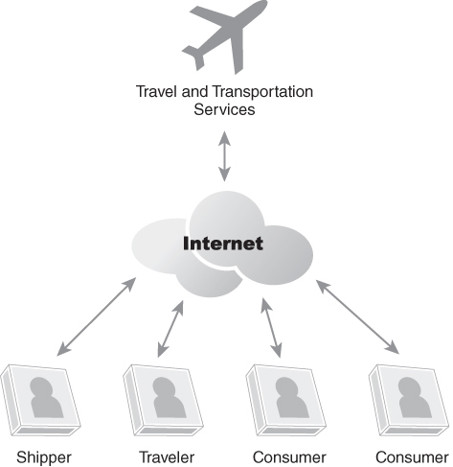
Travel and Transportation Services Challenges
Hotel reservation system communicates with travelers via email or SMS text messaging
Frequent travelers issued hotel room key card with embedded RFID chip for automated check-in
Hotel automation system configures room to traveler’s preferences (Internet access restrictions, environmental controls)
VoIP and UC calls directed to traveler’s laptop via the Internet
FIGURE 2-9 Travel and transportation services business.
Notes:
Specialize in travel arrangements, transportation and shipping
Radio frequency identification (RFID)

Slide 22
Solving Government Business Communication Challenges (1 of 2)
Request for Proposal (RFP) Process
Identify a need
Acquire funding
Issue an RFP
Communicate with prospective respondents
Accept proposals
Select a vendor
Post-RFP procedures
Notes:
Increase in visibility and validation requirements
Doing business with them is subject to inspection
RFP – formal document that describes the problem and requests a solution
RFP phases/steps:
Preliminary – red
Active – yellow
Award - green

Slide 23
Solving Government Business Communication Challenges (2 of 2)
RFP process helps avoid wasting taxpayer money and requires formal communications
UC can help government vendors be compliant:
Multimodal communication enables government businesses to communicate with agency personnel without violating necessary regulations
A UC-enabled environment can make sure all contact with agencies is authorized
The UC system can deny unauthorized contacts and redirect authorized contacts to authorized individuals
The system can also automatically document each contact and alert appropriate people when mandatory action is approaching
A UC system can integrate with a scheduling system to help manage the RFP project
UC can help organizations manage government projects they have won as well
Notes:
RFP limits communication to specific parties, avoiding undocumented information exchange

Slide 24

Solving SMB Business Communication Challenges
A well-planned UC solution can help the SMB in many ways:
Multimodal communication
Comprehensive customer service
Reach more prospects
Maximize resources
“Large company” perception
Measurable feedback

Slide 25

Solving SOHO Business Communication Challenges
Technology and UC solutions can help SOHOs solve their unique problems by:
Extending organic communication
Providing a professional appearance
Leveraging limited resources
Responding to customer needs
Reaching new customers

Slide 26
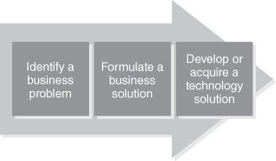
Transforming Communication Requirements into Network Solutions — Communication Challenges
FIGURE 2-11 Transforming business requirements into technical solutions.

Slide 27
notes
UC can provide benefits to many apps:
Service-oriented architecture (SOA)
Customer service (CS)
Customer relationship management (CRM)
Supply chain management (SCM)
Enterprise resource planning (ERP)
Sales force automation (SFA)

Slide 28
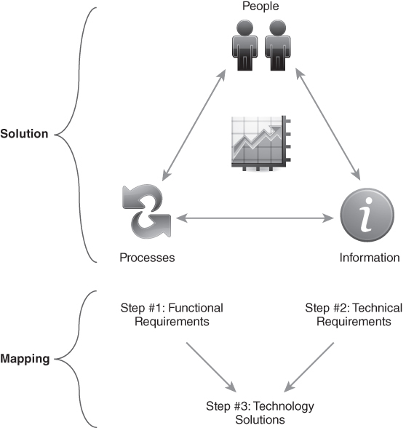
Transforming Communication Requirements into Network Solutions — Communication Solutions
FIGURE 2-12 Solving communication challenges.
Notes:
After the steps at the mapping stage:
Define scope of work
Schedule activities
Execute plan
Monitor solution

Slide 29
notes
Connectivity concerns that impact organizations:
Enterprise connectivity
Departmental connectivity
Remote connectivity
Mobile connectivity
Customer service delivery connectivity

Slide 30
Defining Your Organization’s Networking Requirements
High availability
Bandwidth
Physical infrastructure
Hosting infrastructure
Physical and logical topology
Quantity and types of endpoints
Access controls
Remote access
System/ application/data connectivity
Network security
Network operations
Network management

Slide 31
Summary
Business communication challenges
How the public sector and private industry solve business communication challenges
How to transform communication requirements into network requirements
How to define an organization’s networking requirements

Slide 32
notes
Each type of organization tends to compete for different customers. False
What could describe a company with five employees? SMB and SOHO
What is not a common business challenge for enterprise organizations? Manage time resources
What property of data security makes sure that only authorized users can modify data? Integrity
A BCP is primarily focused on ensuring what network requirement to support an organization’s operation? High availability
What communication challenge do enterprise and/or SMB organizations encounter that SOHO generally do not encounter? Communicating among geographically diverse offices
What term describes a critical step in the government agency procurement process? Request for proposal (RFP

Slide 33
notes
Why do government agencies require so much oversight and open comms? All budgeted funds originate from taxpayers.
What communications challenges do SOHO organizations normally encounter that enterprise generally do not? Avoid appearing small
Every technical solution should start by identifying a Business problem

Slide 34
quiz
Frequent traveler cards with radio frequency identification (RFID) technology enable travelers to use the same card as the hotel room key. True
Government agencies emphasize a customer service model in which they are normally in touch directly with their customers while enterprises tend to focus more on mandates and budget limitations. False (the opposite is right)
When users access applications in the cloud, the wide area network (WAN) limits overall application performance True
Isabelle is a network engineer for a SMB. She is evaluating the suitability of the company network to support a new UC system. What network element has the most impact on the quality of real-time video chat? Bandwidth
What challenge do enterprise and small businesses have in common? They tend to compete for the same customers
What assures that only authorized users can modify data? Integrity
What most heavily relies on requests for proposal (RFPs) as primary method of procuring services and products? Government

Slide 35
quiz
1 reason why cyber attackers target small businesses is because enterprises tend to use more comprehensive security solutions. True
A challenge for organizations that are geographically spread out is effective communications throughout the organization. True
Due to limited resources, what has the greatest challenges reaching the customer, managing time, meeting customer needs, and maintaining security? Small office/home office (SOHO)

